Slide 1
Procedural Terrain Generator
Team: Andersen T. & Chavez M.

Slide 2
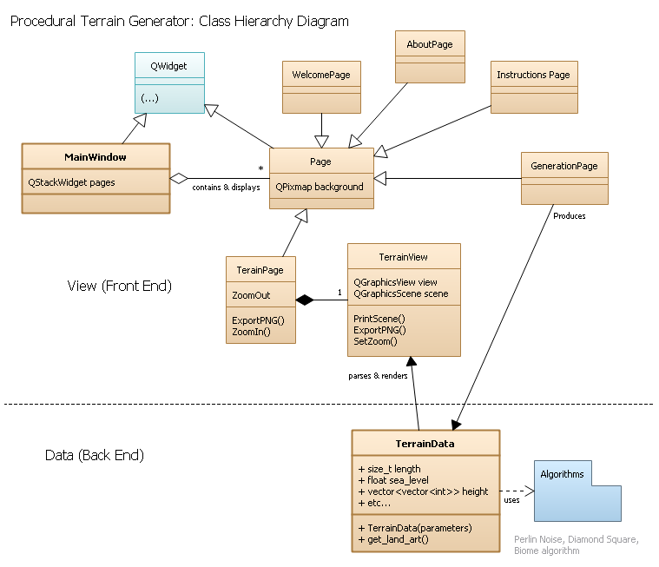
Hierarchy Changes
No more Generator<T> interface or TileMap<T> template…
TerrainData contains everything for making a terrain.
Each terrain property is just a std::vector<std::vector<T>>
Generates terrain on construction from a handful of parameters.
Also manage QGraphicsView and QGraphicsScene in a separate object, TerrainView.

Slide 3
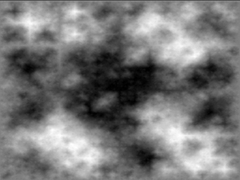
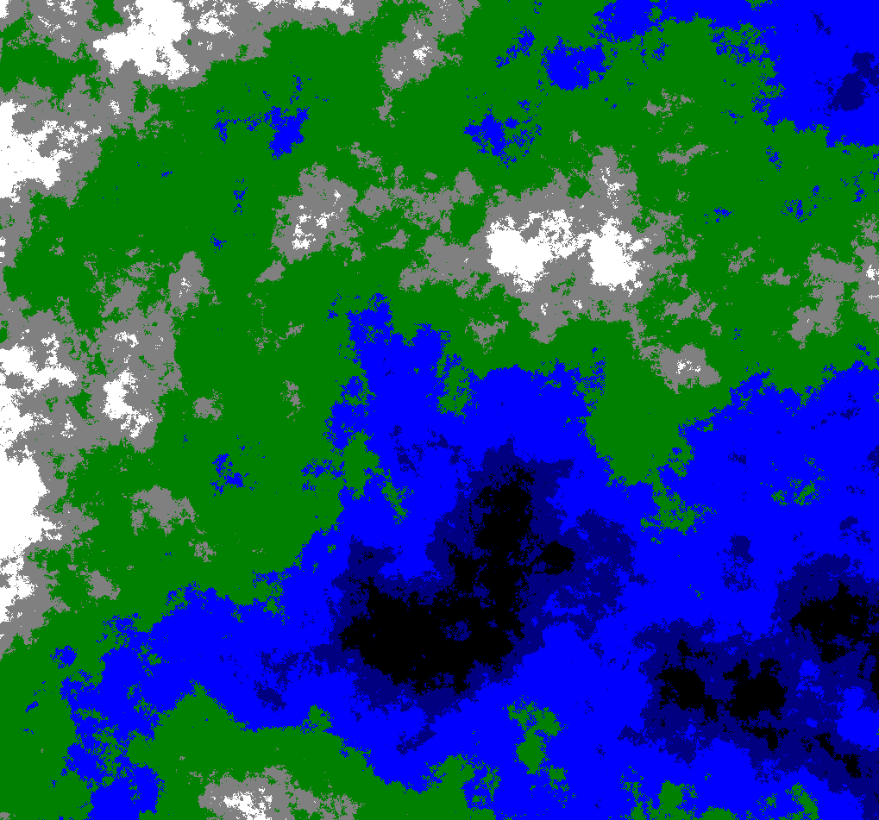
Height Map - Diamond Square Algorithm
Enables to impose sea levels
Distinguish land from ocean
Valleys, hills, and mountains

Slide 4
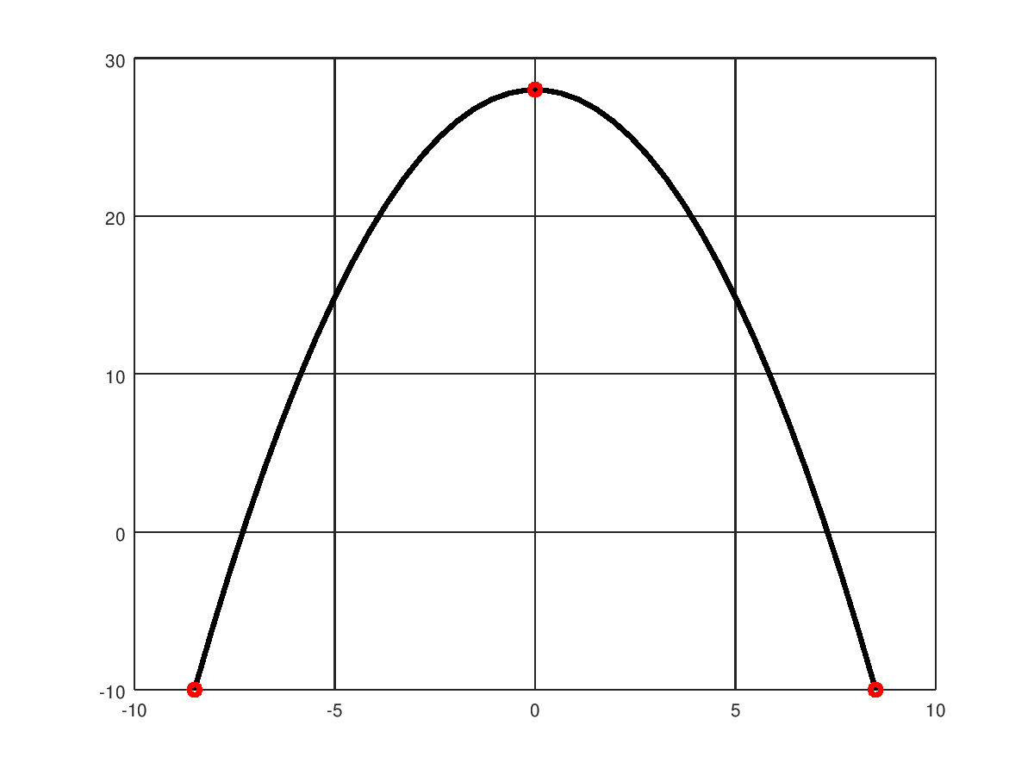
Temperature Mask
Consider a 17x17 map
X = 0 is equator
X = 17/2 is north pole
X = -17/2 is south pole
Temperature of tile == F(distance_from_equator)

Slide 5
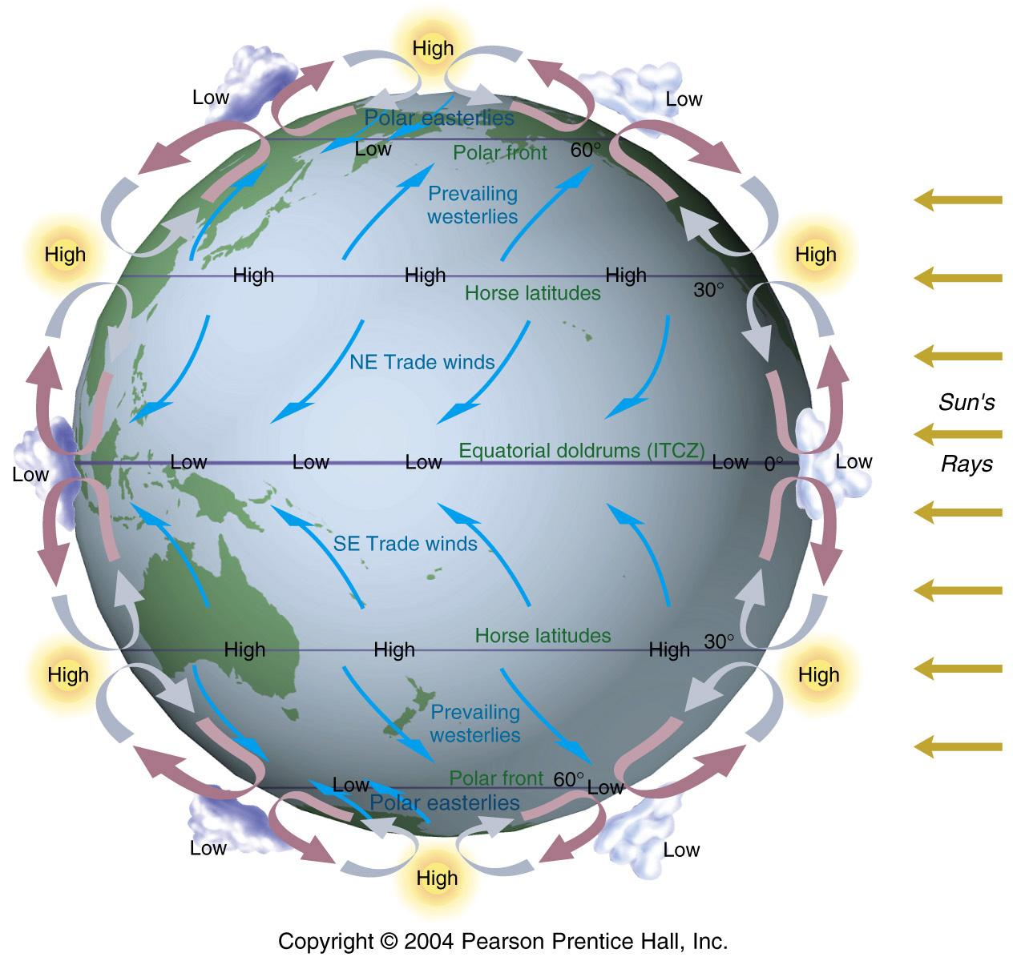

Moisture mask

Slide 6
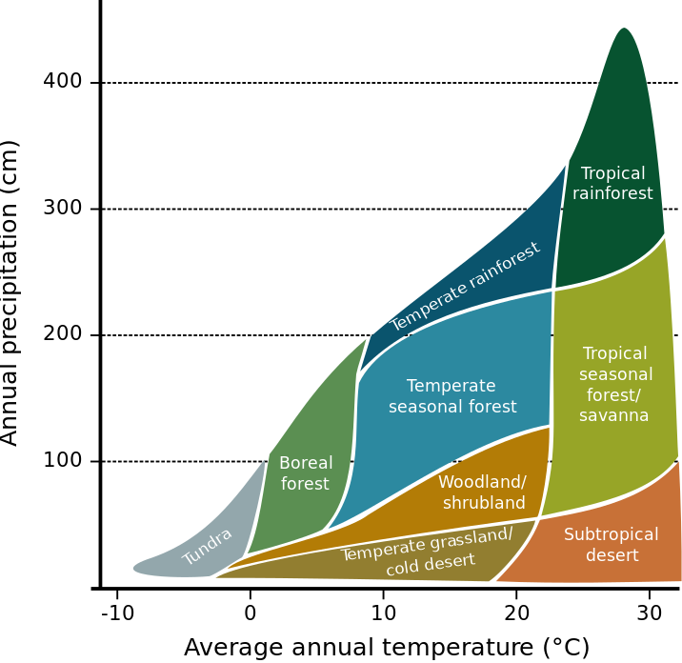
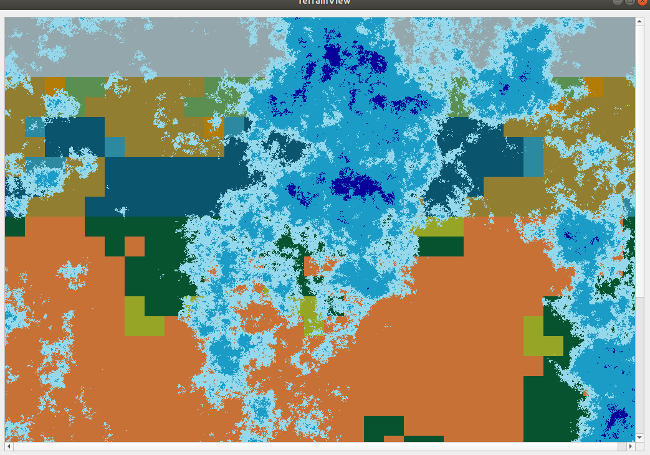
Biomes
Every tile has a value for temperature and “moisture”
Precipitation scaled to 0-40

